Slide 1

GitHub Copilot
Full stack app development using GitHub copilot chat

Slide 2
Project intro
Full stack application with Front end, back end, database and authentication

Slide 3





Stack Overview
Next.js
Shadcn UI + tailwind css
Postgres db on Neon
Drizzle ORM
Clerk for authentication
zod

Slide 4
Next.js Project Setup
Inside terminal
npx create-next-app@latest tinylinkproject
Follow steps : use recommended defaults
Shift to tinylinkproject folder
Open a new vs code window from there (code .)

Slide 5

Installing shadcn UI
Go to ui.shadcn.com/docs/installation
Select
Under npm copy the command
  npx shadcn@latest init

Slide 6
Setup clerk for authentication
Go to clerk.com -> dashboard
Under free tier , create a new application
Name the app as tinylink
Select only email as sign in option
Copy the code from copy prompt button
and paste it inside chat window as Agent
mode
Rename files
  Middleware – proxy
  .env.local – .env

Slide 7
Setup database on neon
Go to neon.com
Create a new project
Select aws with latest version

Slide 8
Setup and install drizzle.com
Go to orm.drizzle.team
npm i drizzle-orm @neondatabase/serverless dotenv
Run these commands
  npm i drizzle-orm @neondatabase/serverless dotenv
  npm i -D drizzle-kit tsx
Add this to .env file
Go to neon site , click on connect and copy connection string and add after above DATABASE_URL=
Bring api keys from clerk.com and paste inside .env file

Slide 9
Create schema
In the root folder create a new directory called db
Inside that folder create a new file index.ts
Copy the code from drizzle orm step 3 and paste inside index.ts
In const db line add “!” After dabase url
And finish that code with export {db};

Slide 10
Create schema(contd..)
Step 4 , we want it to be done by GitHub copilot
Create a file in root directory “drizzle.config” and inside that add step 5 code from drizzle.orm
Remove src from the link as there is not src folder in our project
Inside db folder add a new file schema.ts
Save all files and run npm run dev

Slide 11
Custom agents
& custom prompts

Slide 12
What is Custom Agent
Custom agents is an expert in creating agent instruction file or documentation files specific to LLMs to read
Also we will look into custom prompts , custom slash commands , specifically to create instruction file
Let us use AGENTS.md as a global instructions file
  So create a new file with name AGENTS.md in the root directory
  Restart vsCode
  Now you see the context given is agents.md in the chat window
https://github.com/orgs/community/discussions/175649

Slide 13
Instruction to create instruction files
In the chat window with Agent mode open
  “build out the content for this agent instructions file for this project. This is an instructions file specifically for LLMs to adhere to the coding standards for this project. Agent instructions will be separated out into separate .md markdown files in /docs directory”
  We are following an unofficial way which is beneficial for us to work different AI tools which are supporting AGENTS.md file.
  Make sure that all files generated are understood carefully and tweak them if necessary

Slide 14
Instruction to create instruction files contd…
Just remove all files in the /docs directory
Remove the references of those files in AGENTS.md
And add a text in AGENTS.md where the title of reference files , is there:
  “ALWAYS refer to relevant .md file BEFORE generating any code
Generally text written in Capital Letters are more likely adhered by LLMs
Also add this text below instructions file title
  For detailed guidelines on specific topics, refer to the modular documentation in the `/docs` directory.

Slide 15
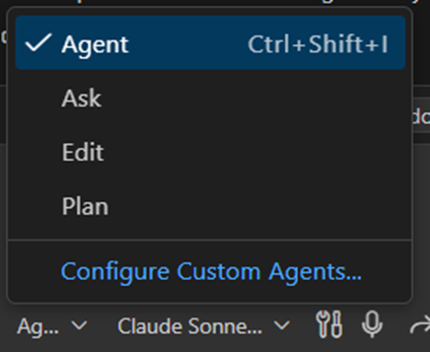
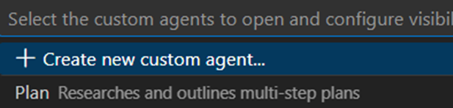
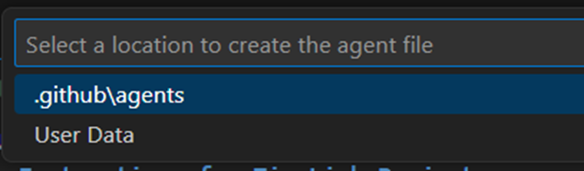
Creating individual instruction files for the architecture
Here we require custom agent and custom prompts
So, how to get custom agents, Inside the chat window there are 4 modes of agents and one more option “Configure Custom Agent”.
Follow the steps on the scree, and give a name as instruction-generator.
You will notice a new .md file added “instructions-generator.agent.md” , under github/agents directory

Slide 16
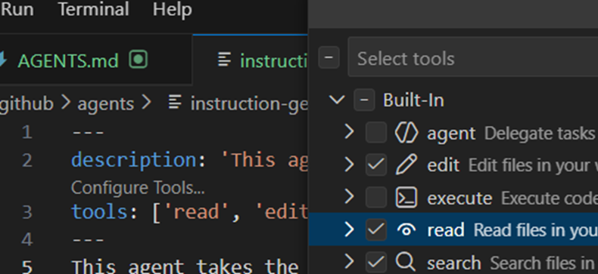
Creating individual instruction files for the architecture … Contd…
Change the description – “This agent generates highly specific agent instruction files for the /docs directory”
Name : Instructions generator
A prompt appears configure tools, click on that
And select edit, search, read, webfetch
Give a description – “This agent takes the provided information about a layer of architecture or coding standards withing this app and generates a concise and clear markdown file suitable for inclusion in the /docs directory.”
Save File

Slide 17
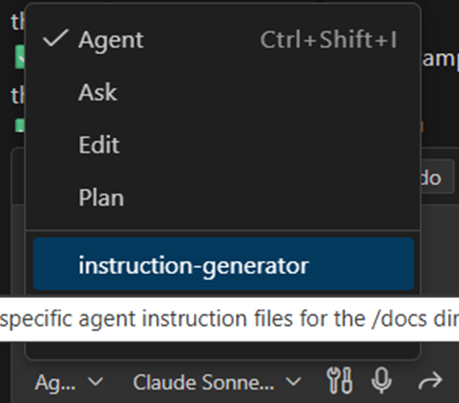
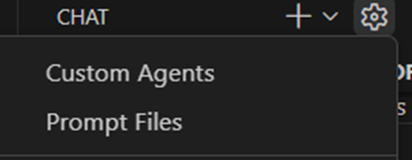
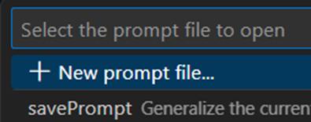
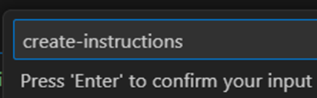
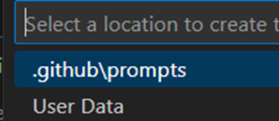
Using Custom Agents
Before start using Custom Agents, lets create a custom prompt to generate an instruction file
Once you open the agent modes, now you will notice an agent option “instruction-generator”
Create a custom prompt using the instructions and name the custom prompt as create-instructions
You will notice in the file explorer a new file added create-instructions.prompt.md
Inside that file give the agent : instruction-generator
Description: Take the information below and generate an agent instructions .md file for it in /docs directory. if a .md file provided, use that otherwise generate an appropriate filename based on the generated content. make sure the instructions are concise and not too long. Make sure to update the AGENTS.md file to reference this new docs file. If no information provided below, prompt the user to give the necessary details about the layer of architecture or coding standards to document.
Now if you start using Slash Command with “/” you will find a Slash Command aka custom prompt
Once you use the custom prompt , the agent mode will be shifted to instructor-generator (custom agent) and accordingly rest of the action happens.

Slide 18
Generate instruction files with new custom agent prompt
In the chat window first start with /create-instructions and then start the chat text
  “everything to do with auth in this app is handled by clerk NO OTHER AUTH METHOD SHOULD BE USED.
  The /dashboard page is a protected route and must require the user to be logged into be able to access this page.
  It the user is logged in and trying to access the homepage, they should be redirected to the /dashboard page
  Sign in and signup via clerk should always launch as a modal
After running this prompt you will find a new file generated authentication.md and review the chat result and this .md file as well
Notes:
Read thru authentication.md and AGENTS.md to see what exactly happening and make sure these are as per your coding standards and then keep the files if things are in place.

Slide 19
Creating New Instruction file
UI Elements etc.
We need make sure that always GitHub copilot is always uses shrdcn for all UI Elements
In a new chat window
  /Create-instructions ALL UI elements in this app use shadcn UI. DO NOT create any custom components. ALWAYS use shadcn UI components
Notes:
Read thru authentication.md and AGENTS.md to see what exactly happening and make sure these are as per your coding standards and then keep the files if things are in place.

Slide 20
Implement dashboard page + UI tweaks
Guided by GitHub Copilot instructions
Open a new chat window and select the custom agent
Below chat to be typed
  Create /dashboard page. DO NOT add any content or data fetching just yet, just add a dashboard h1 tag as a placeholder
  Test the webpage by running npm run dev
Another chat prompt
  Make sure this page adhere to the auth coding standards
Another interesting thing here is I am not giving the reference to authentication.md , but the copilot is deciding what to select and how to proceed
Notes:
Read thru authentication.md and AGENTS.md to see what exactly happening and make sure these are as per your coding standards and then keep the files if things are in place.

Slide 21
Implement dashboard page + UI contd..
Guided by GitHub Copilot instructions
Next chat prompt
  Make sure the homepage adheres to the auth coding standards reference authentication.md
  This will help to redirect signed users to dashboard page automatically
Next Chat prompt
  Need the UI in dark mode and new look for sign in and signup button
  Check this result
Another chat prompt
  Make sure the entire app displays as dark mode
  And you will find this changed to complete dark mode
Notes:
Read thru authentication.md and AGENTS.md to see what exactly happening and make sure these are as per your coding standards and then keep the files if things are in place.

Slide 22
Custom agents
Direct edit in vs code (show browser)

Slide 23
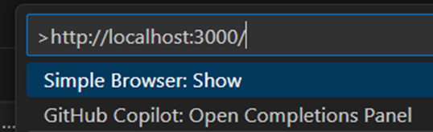
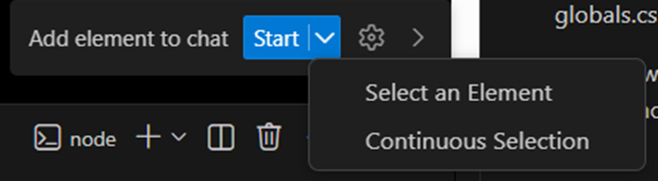
Open Webpage directly in VS Code
Ctrl+shift+P
⌘+shift+P
We can pickup the elements directly in VS code and reference them in the chart and get suggestions.
Ctrl + Shift + P
  Select simple browser – show
  Add the localhose link
Once you can see the browser in VS Code
  bottom-right corner of the screen, you can Continuous selection as shown in the pic
  You can select continuously all elements to add to chat as a reference
  Element will be added as screenshot + the tag reference also will be added
Add instruction to work with the buttons
    Make sure these elements adhere to the uicomponents.md #uicomponents.md
Notes:
Read thru authentication.md and AGENTS.md to see what exactly happening and make sure these are as per your coding standards and then keep the files if things are in place.

Slide 24
AGENTS.md is not referred properly?
After looking at all these issues (if at all you find in the last slide) it seems, copilot chat is not really reading AGENTS.md file for instructions so, we need to manage and reiterate to it.
  NEW CHAT : update the AGENTS.md file to make sure that its incredibly important ot ALWAYS read the relevant individual instruction files withing the /docs directory BEFORE generating ANY code
Notes:
Read thru authentication.md and AGENTS.md to see what exactly happening and make sure these are as per your coding standards and then keep the files if things are in place.

Slide 25

Commit and Publish
We haven’t committed or pushed the changes yet in VS code , go to Source Control and click on copilot sparkles icon, and copy the message (because this is the first commit) and it is too long.
Commit with a simple message as initial message and publish to a public repository and keep the name as it was.
Check the same in github.com and see whether successfully published into GitHub repository.
Notes:
Read thru authentication.md and AGENTS.md to see what exactly happening and make sure these are as per your coding standards and then keep the files if things are in place.

Slide 26
Custom agents cloud agents
Implement landing page with cloud agent

Slide 27
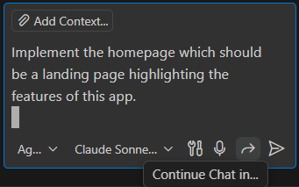
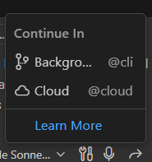
More Agent options…
Add a new chat window and type the below chat
  “Implement the homepage which should be a landing page highlighting the features of this app”.
Click on button to see where you can see Background and Cloud Agent options
Background agents are similar to Chat Agents but they work in the background in a separate work tree and we can hv multiple background agents simultaneously
Once the job is over we can merge those branches in main branch.

Slide 28
Working with cloud agents
If we select on Cloud agents
  They will create a new branch and it start working in cloud
  It creates a virtual browser and tests all the changes made using playwright
  Uses way more resources and accomplish the task, which much time taking
  However it is useful because we can have multiple cloud agents for different tasks.
  So lets work with Cloud agent first

Slide 29
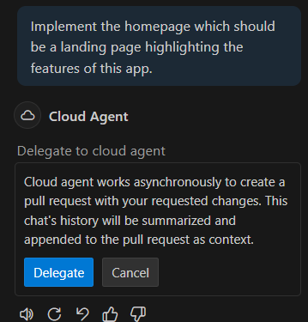
Working with cloud agents contd..
Add this chart prompt
  Implement the homepage which should be a landing page highlighting the features of this app.
From options select cloud agents
A messages shows up to delegate the task to cloud agent
Once you delegate the task started
A WIP of pull request can be seen inside github.com , and 2 branches.
And the cloud agent working on several activities which can be seen inside the pull request
We can work with cloud, background, chat agent simultaneously
Background and Cloud agents work asynchronously

Slide 30
Using mobile app
In the mobile app open the repository and select pull requests
Using copilot chat in mobile you can do necessary changes
Practice

Slide 31
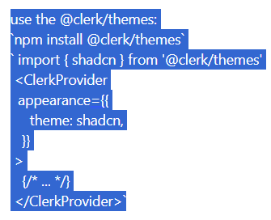
Orchestrating cloud agents and background agents
Description
What ever we are doing here in this slide can be done with mobile app as well
This we, now, are doing using github.com , (not using vscode)
Select issues and add a new issue
Title of issue - Clerk UI Components should display as the shadcn theme
Create the issue
You can assign to copilot or a custom Agent as well ( as shown in the next slide)
Once assigned , copilot is watching on it. (click on pull request , which is WIP)
Themes - Next.js | Clerk Docs ( refer this for themes)

Slide 32
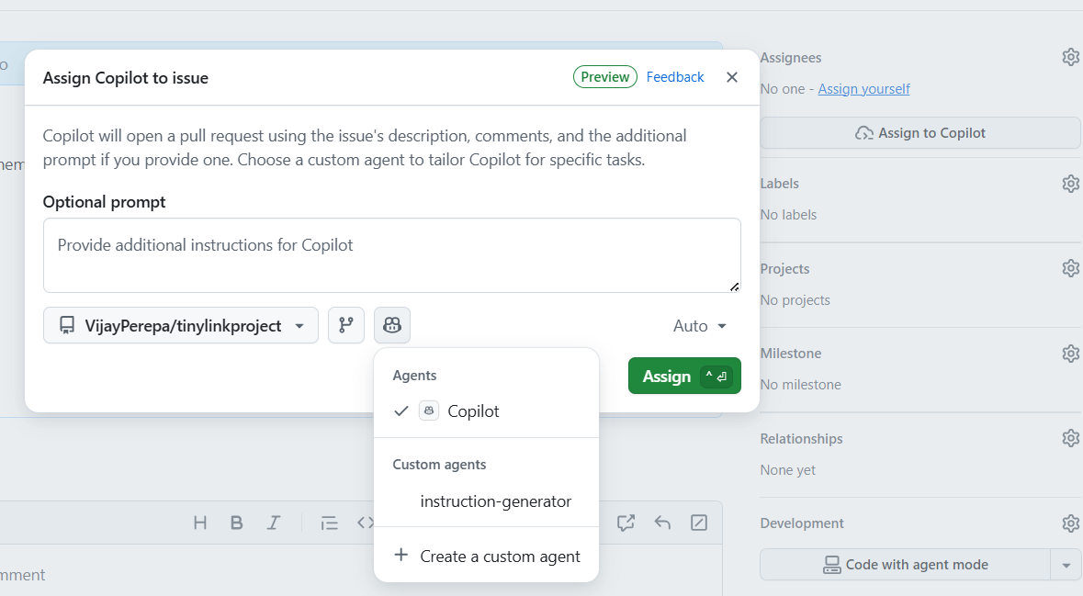
Orchestrating cloud agents and background agents
Description
What ever we are doing here in this slide can be done with mobile app as well
This we, now, are doing using github.com , (not using vscode)
Select issues and add a new issue
Title of issue - Clerk UI Components should display as the shadcn theme
Create the issue
You can assign to copilot or a custom Agent as well
Themes - Next.js | Clerk Docs ( refer this for themes)
Select a right model

Slide 33
Removing additional buttons
Description
@cli , means we are deploying the background agent
remove the deploy now button from the
#file:page.tsx, meaning referring to the page name
Back ground agent creates a new work tree and created a new branch within work tree

Slide 34
Final beautification of page using
Chat Agent
Description
I have used this chat
Change the landing page with more options and better logo as tinyurl and remove next.js logo but follow agents.md and other guidelnes as discussed earlier

Slide 35
Creating database

Slide 36
Create a Table schema
Description
Table schema needs to be created inside schema.ts under db directory
Plan
  In Chat window change the mode to plan
  Context will schema.ts
  Prompt – “plan a very simple table schema to store tiny links”
We are assuming that copilot follows the authentication and coding standards automatically

Slide 37
Create a Table schema contd…
Description
Plan will ask few questions answer them and based on its additional pointers you can give an idea what is your requirement as below: (example)
we donot want any optional fields, we need a createAt, updateAt, Clerk_User_id,Shortcode, and URL to store. all data must store the timezone data. we do not need any click tracking and delets will be permanent.
Also check vulnerability of our db structure and get right answer

Slide 38
Pushing schema to Postgres
Description
In ask mode : “how to push this schema to our postgres db hosted on neon”
Result will be few instructions which needs to posted by us to terminal
Once the job is done go to neon console -> tables->link table and you can find all columns
Now the step to add dummy data

Slide 39
Adding dummy data
Description
To create dummy data we need to co-ordinate with MCP Server
Lets Install MCP Server for Neon
We are using natural language to install all these
Extensions – MCP for Neon – install (copilot chat)
Ctrl Shift P – open user settings – chat gallery MCP and enable settings

Slide 40
Now lets talk to database directly
Description
Switch to agent mode
“list all of the projects in my neon account”
Based on the list, jump to ask mode
We requie neon user id, so go to neon site and get the user id
Then chat “ generate 10 examples for user id (paste user id) use the schema.ts for the correct structure

